Slide 1
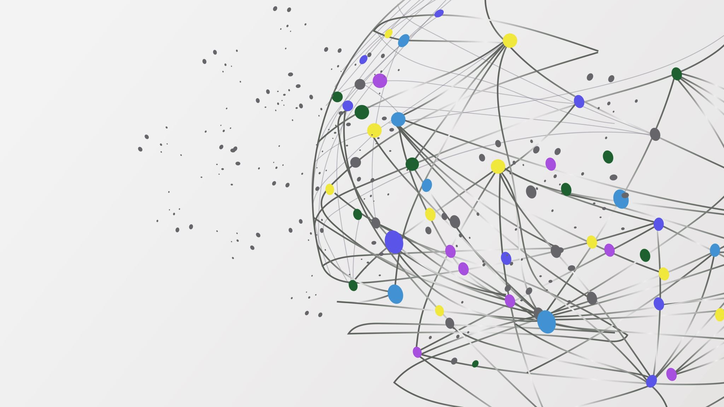
Design Patterns II
Lucky Nkosi

Slide 2
Today: Structural Patterns
Adapter
Bridge
Composite
Decorator
Façade
Flyweight
Proxy

Slide 3



Structural Design Patterns
Structural design patterns deal with organising objects to form larger structures and provide new functionality
They can add functionality to objects
They can control how objects are accessed
They can simplify the process of interacting with objects They can optimise how objects use memory

Slide 4
Consider
Your amazing web app
Cool library that solves problem

Slide 5

Adapter Pattern

Slide 6
Consider
Adapter
Your amazing web app
Cool library that solves problem

Slide 7

Adapter
The adapter pattern, also called the wrapper pattern, allows the interface of a class to be used as another interface for a different class
With the adapter pattern, you can ensure that two classes that expect different interfaces can still communicate
Two variants: object adapter and class adapter

Slide 8
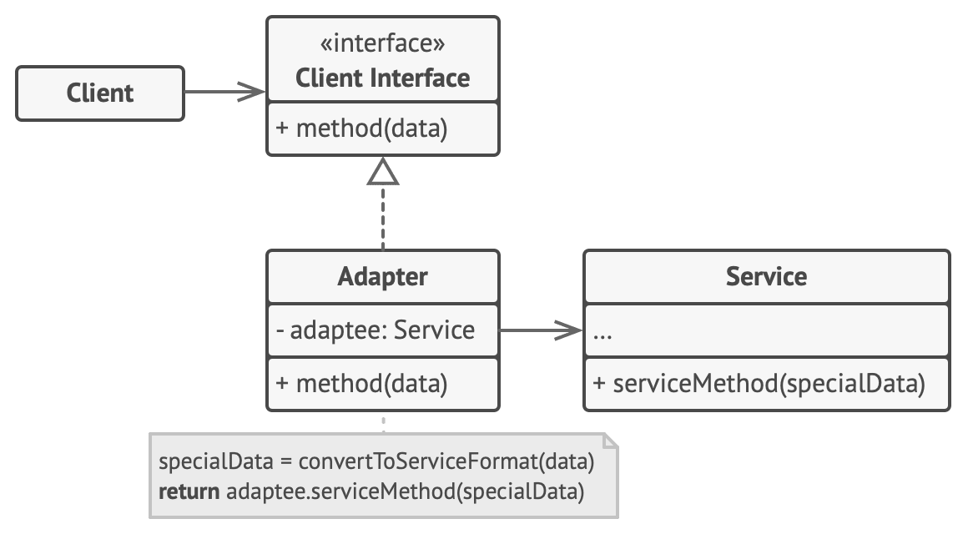
Adapter – Object Adapter
Client interface (a.k.a. Target) – defines the specific interface the client uses Client - collaborates with objects conforming to the client interface
Service (a.k.a. Adaptee) - defines an existing interface that needs adapting Adapter - adapts the interface of Service to the Client interface
●
●
●
●

Slide 9
Adapter – Object Adapter
●
Adapter inherits and implements the interface provided by Client interface and uses composition to use the interface provided by the Service

Slide 10
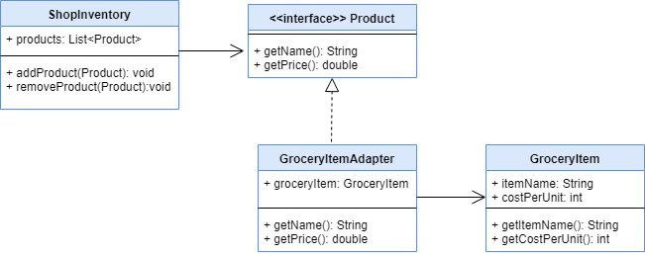
Adapter – Object Adapter
●
Example: shopping inventory and grocery items
●
Note: suppose the company implementing ShopInventory is different to the grocery store that implements GroceryItem, thus GroceryItem doesn’t implement Product interface

Slide 11
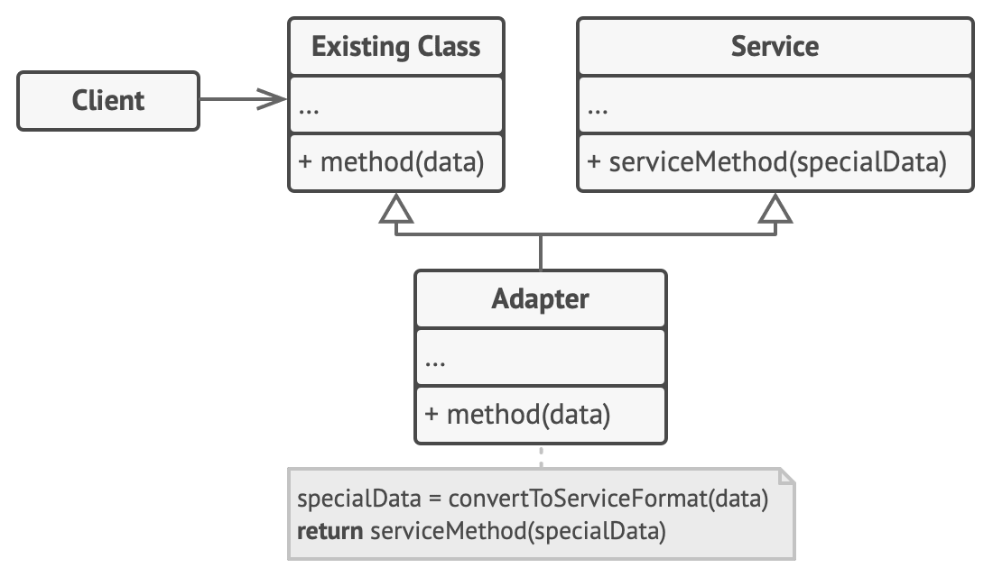
Adapter – Class Adapter
●
Class Adapter – same as object adapter, but now the Adapter uses multiple inheritance to implement both interfaces simultaneously
●
Only works in languages that support multiple inheritance (C++, Python, Perl, etc.)
Or, you can use clever tricks to mimic: see Twin Pattern
●

Slide 12
Adapter – Object vs Class
●
Object adapter:
●
lets a single Adapter work with many Services—that is, the Service itself and all of its subclasses (if any)
makes it harder to override Service behavior. Requires subclassing Service and making Adapter refer to the subclass rather than the Service itself
●
●
Class Adapter
Can’t work with many Services
lets Adapter override some of Service’s behavior, since Adapter is a subclass of Service
●
●

Slide 13
Adapter
●
Use adapter when:
●
you want to use an existing class, and its interface does not match the one you need
you want to create a reusable class that cooperates with unrelated or unforeseen classes, that is, classes that don't necessarily have compatible interfaces
you need to use several existing subclasses, but it's impractical to adapt their interface by subclassing every one
●
●
●
Object adapter only - object adapter can adapt the interface of its parent class

Slide 14
Adapter
●
Pros:
●
You can separate the interface or data conversion code from the primary business logic of the program
●
Single responsibility principle
●
You can introduce new types of adapters into the program without breaking the existing client code, as long as they work with the adapters through the client interface
●
Open-closed principle
●
Cons:
●
New interfaces and classes can increase complexity and computation
●
Sometimes simpler in the long run to refactor Service to use Client interface

Slide 15

Bridge Pattern

Slide 16
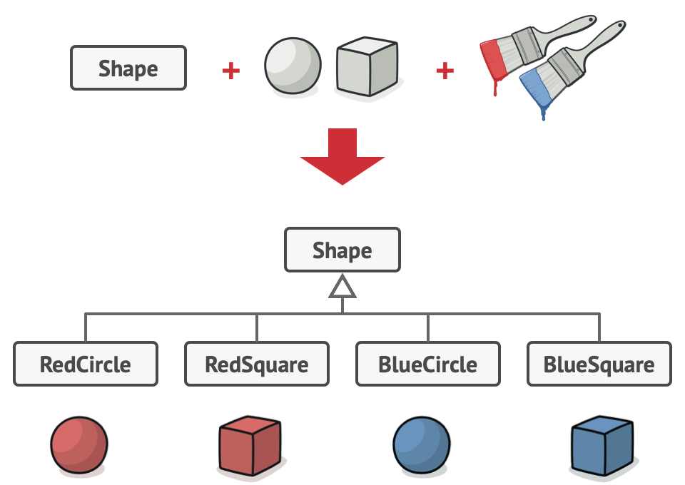
Bridge
Motivation: adding features to an interface may force you to have multiple subclasses representing configurations of that interface
Notes:
Let’s say we have shjapes – circle & square. We decide to add colour to it 1*
..adding to it grows the classes we need exponentially.

Slide 17
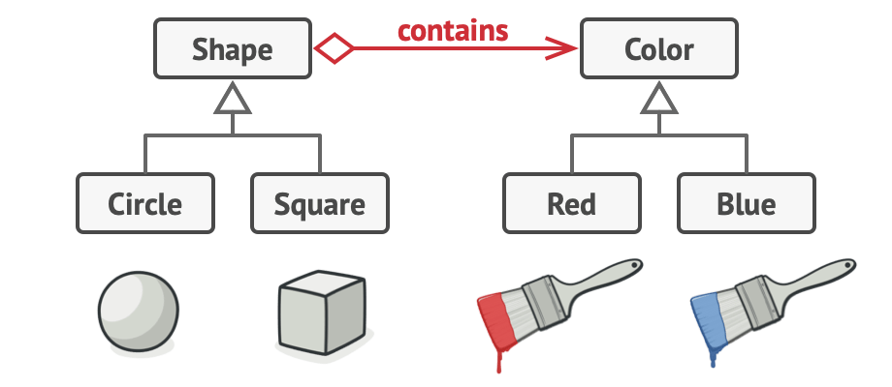
Bridge
●
Motivation: with the bridge pattern, we can separate large classes into separate hierarchies of classes

Slide 18
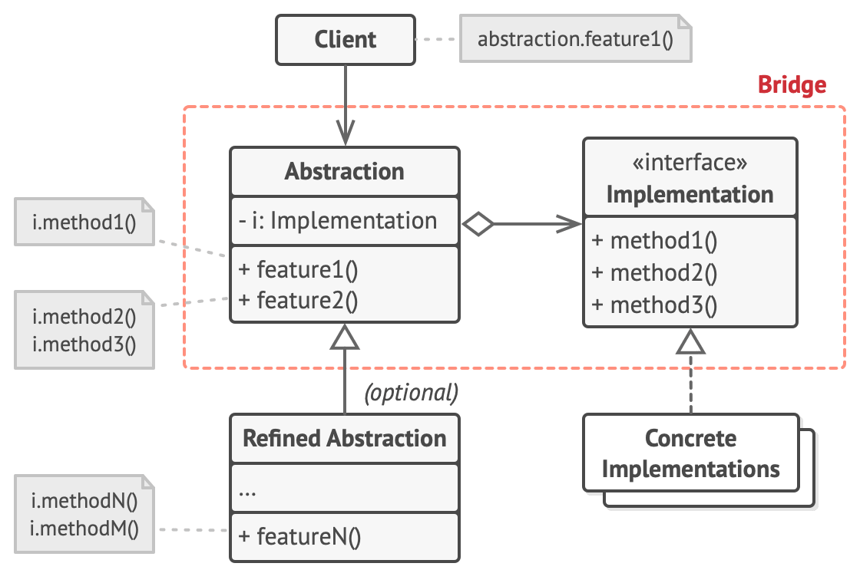
Bridge
●
The bridge pattern facilitates the decoupling of an abstraction from its implementation, allowing the two to develop separately
Bridge allows you to split a large class or collection of classes into two separates hierarchies

Slide 19
Bridge
●
Abstraction – defines an interface, references the Implementor
RefinedAbstraction – extends the Abstraction
Implementation – declares the interface used by ConcreteImplementations
ConcreteImplementation – implements the Implementation interface
●
●
●

Slide 20
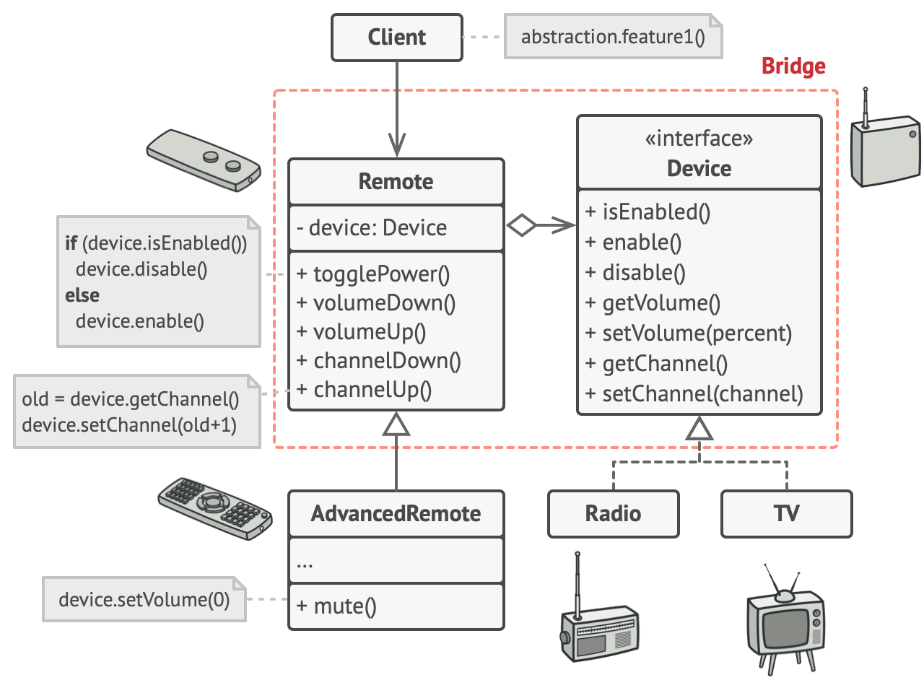
Bridge
●
Example: remotes for devices

Slide 21
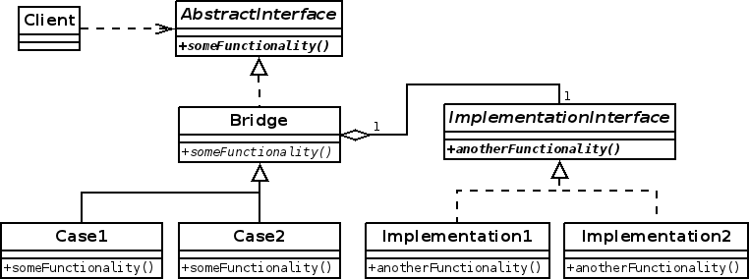
Bridge vs Adapter
●
Bridge and adapter often confused as both allow separate classes / class hierarchies to communicate
Adapter is often applied to existing systems to get separate components to work together
Bridge is often implemented up-front to allow abstractions and implementations to develop separately
●
●
●
Implementations of the bridge pattern often use an object adapter

Slide 22
Bridge
●
Use bridge when:
●
you want to avoid a permanent binding between an abstraction and its implementation
●
e.g. when implementation is selected at runtime
●
both the abstractions and their implementations should be extensible by subclassing
rewriting an implementation of the abstraction shouldn’t force a rewrite of the client
●

Slide 23
Bridge
●
Pros:
You can create platform-independent classes and apps
The client code works with high-level abstractions. It isn’t exposed to the platform details
You can introduce new abstractions and implementations independently from each other
●
●
●
●
Open-close principle
●
You can focus on high-level logic in the abstraction and on platform details in the implementation
●
Single responsibility principle
●
Cons:
●
You might make the code more complicated by applying the pattern to a highly cohesive class

Slide 24

Composite Pattern

Slide 25
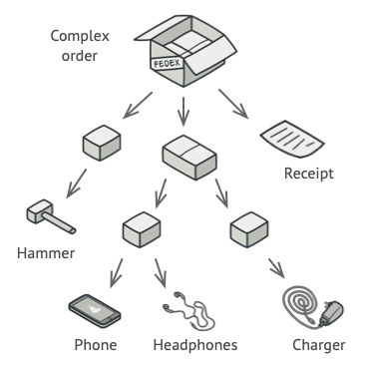
Consider
Notes:
Say we want the price – we can’t ust loop through. We could delegate the work to each child and ensure they implement core functionality that we need through out and (almost) recursively get totals.

Slide 26
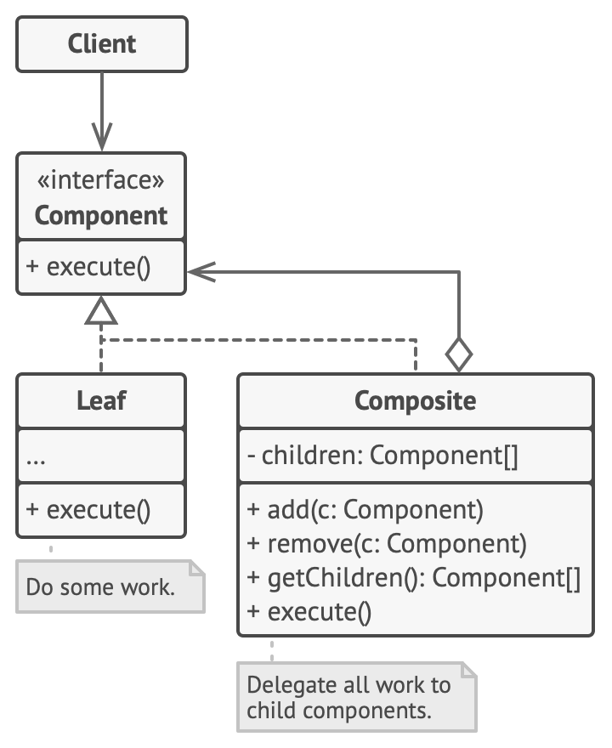
Composite
●
The composite pattern allows for objects to be composed as tree structures, and then treat individual objects and these tree structures the same way
Notes:
They both implement the execute

Slide 27
Composite
●
Component – declares interface for objects in the composition, as well as methods for accessing children and (optionally) parents
Leaf – defines primitive behaviour in the composition. Has no children.
Composite – defines behaviour for having children, stores children and implements child- related methods
●
●

Slide 28
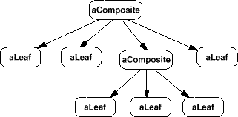
Composite
●
Instantiated structure of composite pattern

Slide 29
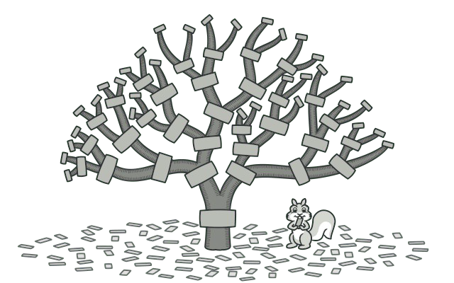
Composite
●
Use composite when:
you want to represent hierarchies of objects in a tree structure
you want clients to be able to ignore the difference between compositions of objects and individual objects. Clients will treat all objects in the composite structure uniformly
●
●

Slide 30
Composite
Pros:
You can work with complex tree structures more conveniently: use polymorphism and recursion to your advantage
You can introduce new element types into the app without breaking the existing code, which now works with the object tree
Open-closed principle
Cons:
It might be difficult to provide a common interface for classes whose functionality differs too much. In certain scenarios, you’d need to overgeneralize the component interface, making it harder to comprehend

Slide 31

Decorator

Slide 32
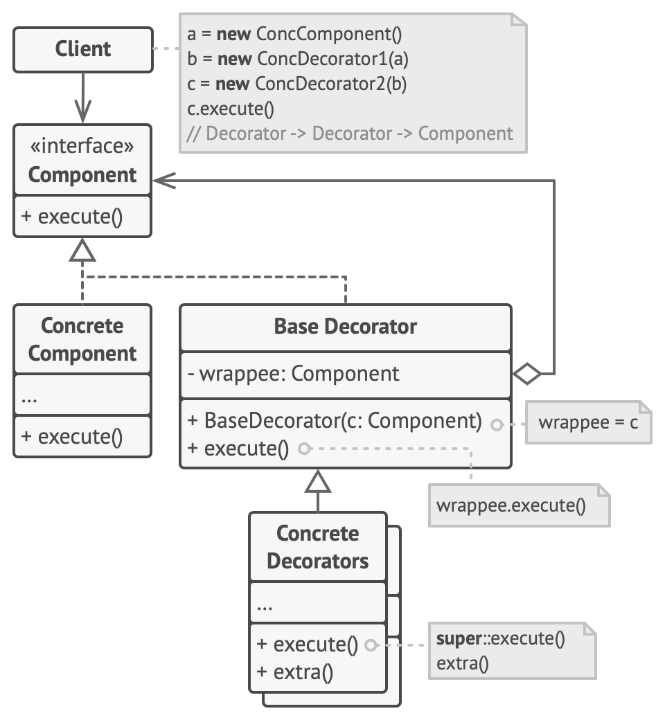
Decorator
The decorator pattern, sometimes called the wrapper pattern (not to be confused with the adapter pattern, which shares this alternate name) allows for behaviour to be added to an individual object without affecting other objects of the same class
Notes:
We use the decorators to extent functionalit, passing the actual component each time. Diff from composite because top level client decides what combination of cuntionality to use while the previous went recursively through a tree-like structure

Slide 33
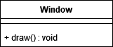
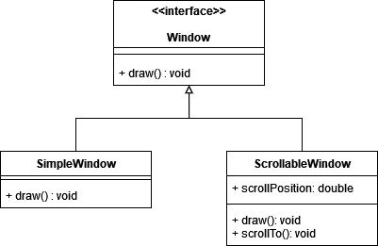
Decorator
●
Motivation: suppose we have a editor that let’s us add windows to a GUI
●
We now use inheritance to extend functionality to add a scroll bar to the window

Slide 34
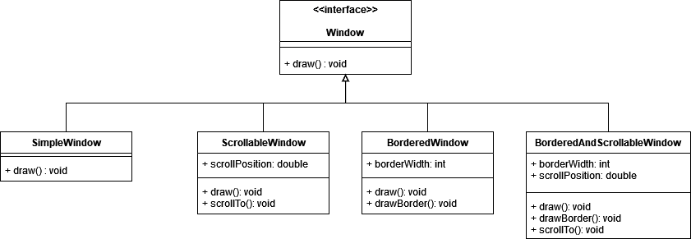
Decorator
●
Motivation: suppose we now add a border functionality to a window
●
If we want a class to have a border and a scroll bar, we need an extra class
Notes:
Class explotion

Slide 35
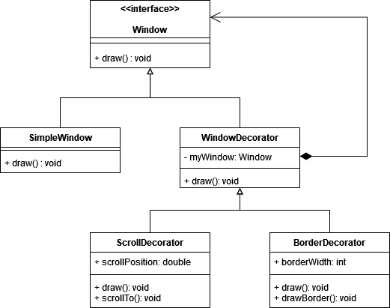
Decorator
Motivation: if we take advantage of object composition, we can add extra functionality to individual objects using a decorator class

Slide 36
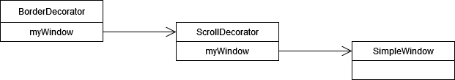
Decorator
●
Motivation: view of object references

Slide 37
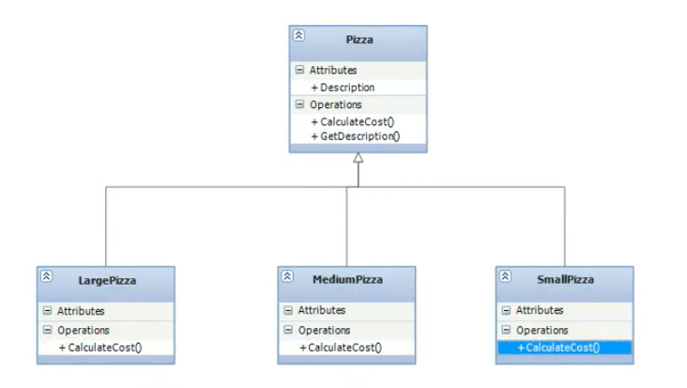
Decorators
Notes:
What if we want to start adding toppings functionality? We’d need to increase our classes. A class for a pizza with cheese & ham & tomato etc. All diff combinations

Slide 38
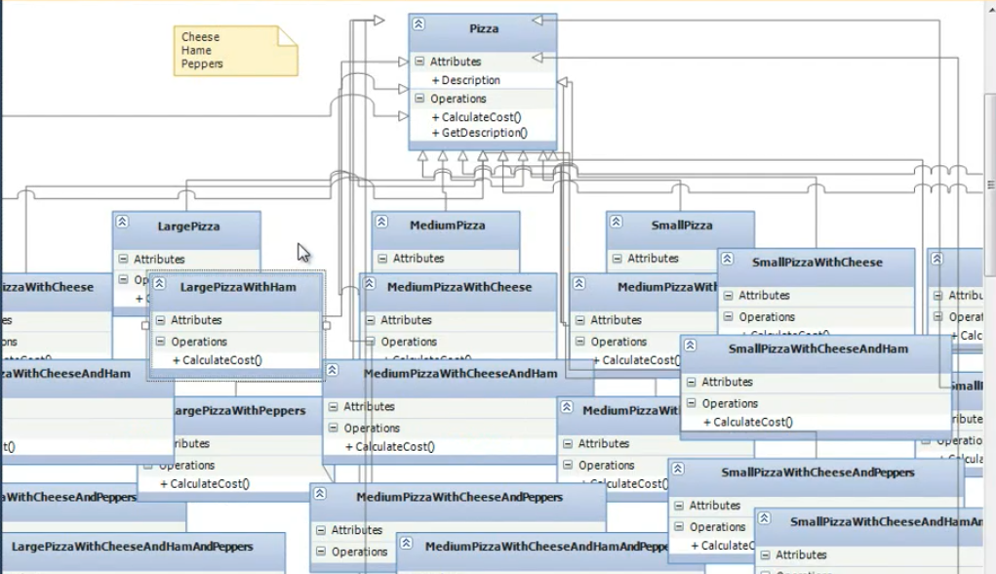
Decorators
Notes:
If we used inheritance to just create new classes, we’d have class explosion, especially since C# does not support multiple inheritence

Slide 39
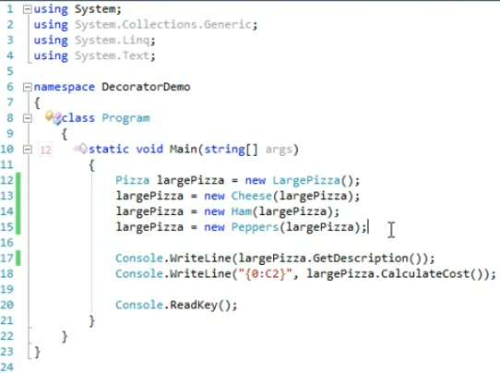
Pizza Decorators

Slide 40
Decorator
●
Component – defines interface for objects that can be decorated
ConcreteComponent – defines an object to which additional features can be added
Decorator – references a Component object and conforms to the Component interface
ConcreteDecorator – adds features to the Component
●
●
●

Slide 41
Decorator vs Adapter
●
Adapter:
●
changes the interface of an existing object
●
Decorator:
enhances an object without changing its interface supports recursive composition
●
●

Slide 42
Decorator
●
Pros:
You can extend an object’s behavior without making a new subclass You can add or remove responsibilities from an object at runtime
You can combine several behaviors by wrapping an object into multiple decorators
You can divide a monolithic class that implements many possible variants of behavior into several smaller classes
●
●
●
●
●
Single responsibility principle
●
Cons:
It’s hard to remove a specific wrapper from the wrappers stack
It’s hard to implement a decorator in such a way that its behavior doesn’t depend on the order in the decorators stack
The initial configuration code of layers might look pretty ugly
●
●
●

Slide 43
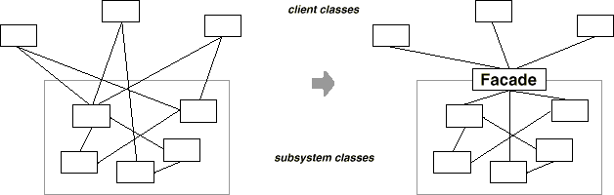
Facade
●
The facade pattern allows an object to act as a simplified interface for a client to access more complex underlying code

Slide 44
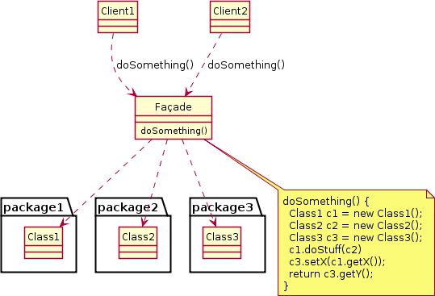
Facade
●
Facade – provides an interface for and controls access to some underlying subsystem

Slide 45
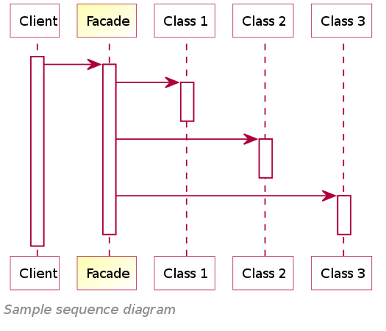
Facade
●
Example sequence diagram

Slide 46
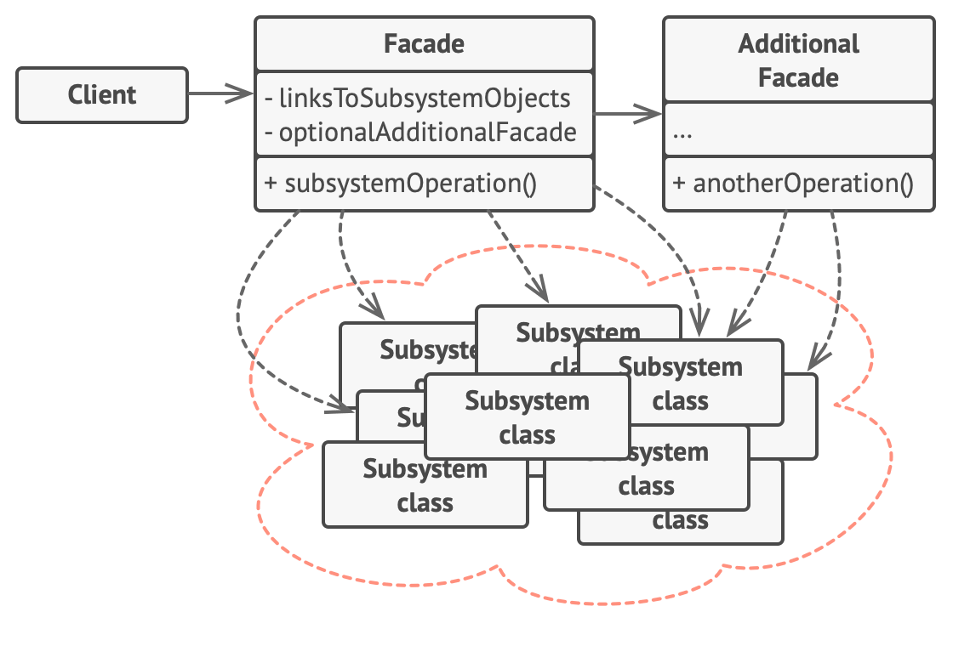
Facade
●
Additional facades can prevent a single facade from becoming too complex itself
●
Can be called by clients or facades

Slide 47
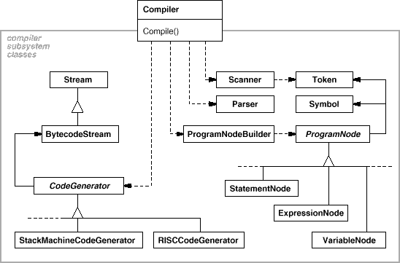
Facade
●
Example: compiler
Note: this particular diagram uses older OMT syntax, not UML

Slide 48
Facade
●
Use facade when:
you want to provide a simple interface to a complex subsystem
there are many dependencies between clients and the implementation classes of an abstraction
●
●
●
Facades decouple clients from the subsystem
●
you want to layer your subsystems
●
Facades define an entry point to the subsystem

Slide 49
Facade
●
Pros:
●
You can isolate your code from the complexity of a subsystem
●
Cons:
●
A facade can become a god object coupled to all classes of an app
●
Can mitigate with additional facades, but too many additional facades reintroduces complexity

Slide 50
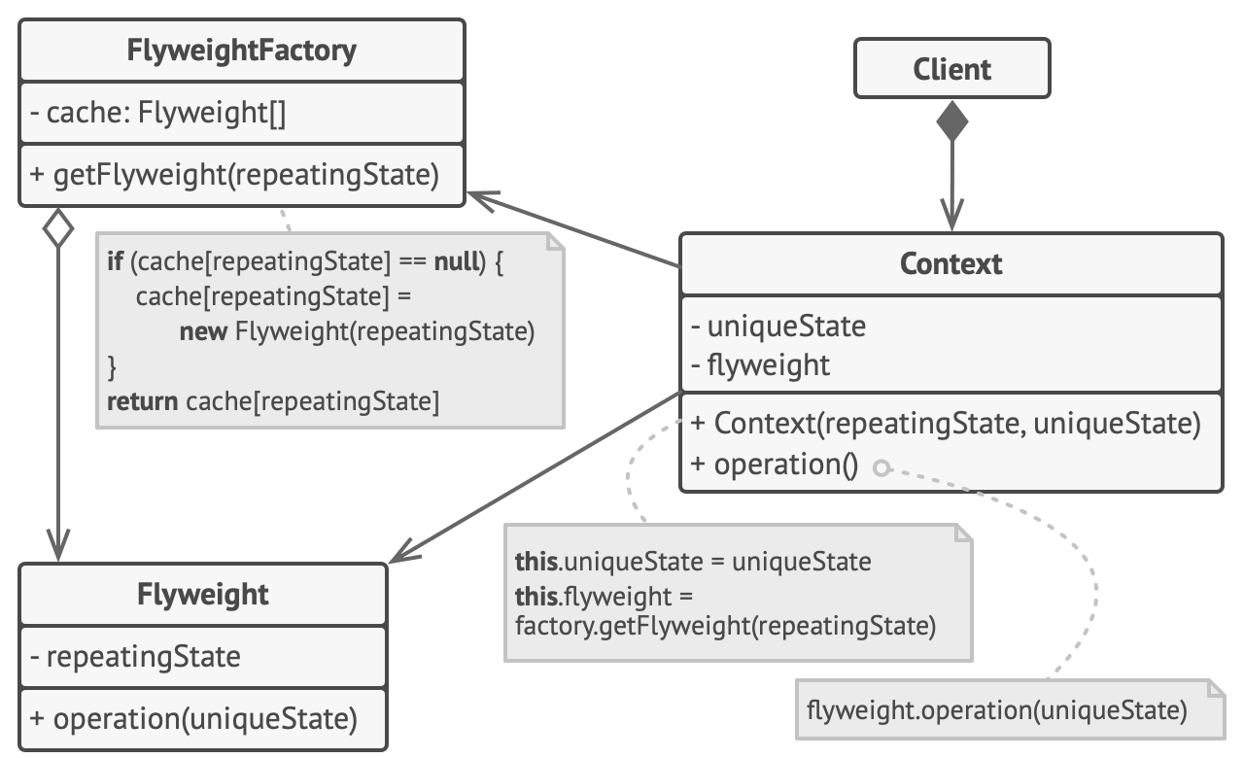
Flyweight
●
The flyweight pattern allows objects to reduce their memory usage by sharing resources with other, similar objects.

Slide 51
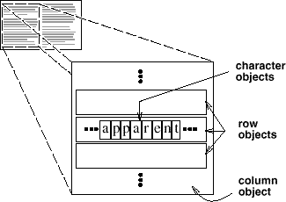
Flyweight
●
Motivation: consider a word processor handling text
●
Every character, row and column is a separate object

Slide 52
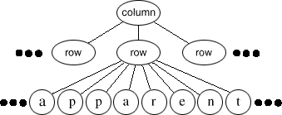
Flyweight
●
Motivation: in a document with many thousands of characters, memory usage could grow very large
●
Each character object needs to store character code, font, font weight, font size, colour, position, etc.
Typically, a document only uses a few characters, with other information available from context
●

Slide 53
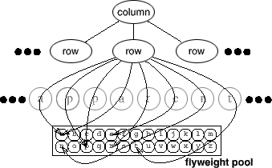
Flyweight
●
Motivation: instead, maintain pools of shared objects (called flyweights) that store character code, and pass other information (like position, font, colour, etc.) as a context whenever the character is drawn

Slide 54
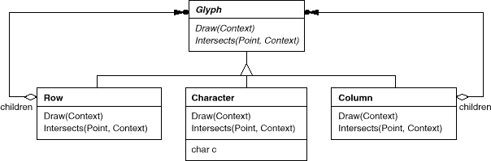
Flyweight
Motivation: client is responsible for storing and passing context, flyweight (Character) is responsible only for operations relating to a particular character
Note: this particular diagram uses older OMT syntax, not UML

Slide 55
Flyweight
●
Some useful definitions:
●
A flyweight is a shared object that can be used in multiple contexts simultaneously
An intrinsic state is a state consisting of information that is independent of a flyweight’s context. It is shared and typically immutable.
●
●
e.g. character code
●
An extrinsic state is a state that depends on and varies with a flyweight’s context. It is not shared and is typically mutable.
●
e.g. position, font, font size, colour, etc.

Slide 56
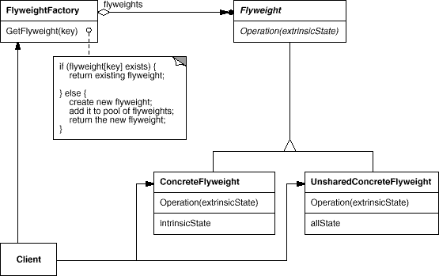
Flyweight
●
Flyweight - declares an interface through which flyweights can receive and act on extrinsic state
●
e.g. Glyph
●
ConcreteFlyweight - implements the Flyweight interface and adds storage for intrinsic state, if any
must be sharable
Any state it stores must be intrinsic
●
●
I.e. independent of the ConcreteFlyweight object's context
e.g. Character
●
●

Slide 57
Flyweight
●
FlyweightFactory - creates and manages flyweight objects. Also ensures flyweights are shared properly
Context – maintains a reference to flyweights and computes and stores extrinsic state
●

Slide 58
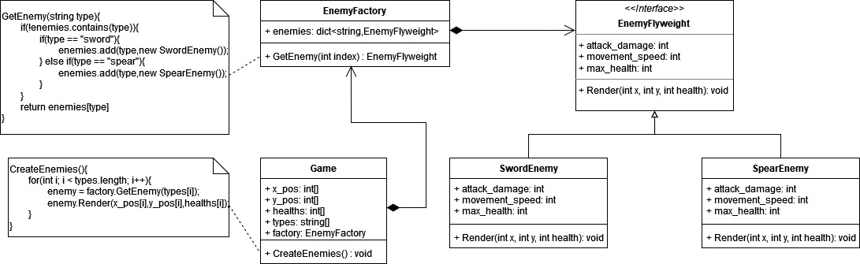
Flyweight
●
Example: video game enemies
Intrinsic – attack_damage, movement_speed, max_health Extrinsic – x_pos, y_pos, health
●
●

Slide 59
Flyweight
●
Use flyweight when:
an application uses a large number of objects, and memory costs are high because of number of objects, and most object state can be made extrinsic, and
many groups of objects may be replaced by relatively few shared objects once extrinsic state is removed
●
●
●
●

Slide 60
Flyweight
●
Pros:
●
You can save lots of RAM, assuming your program has tons of similar objects
●
Cons:
●
You might be trading RAM over CPU cycles when some of the context data needs to be recalculated each time somebody calls a flyweight method
The code becomes much more complicated
●

Slide 61
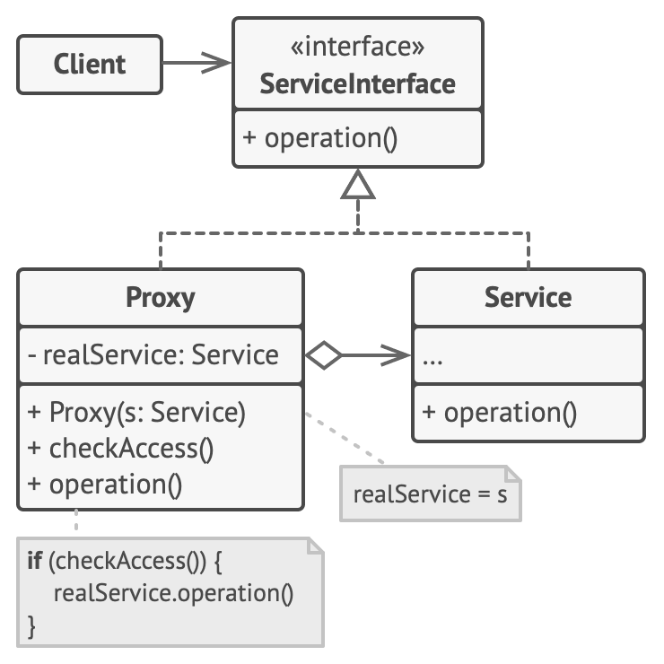
Proxy
●
The proxy pattern, also called the surrogate pattern, allows one to control access to an object via a proxy object.
●
The proxy object can perform pre- or postprocessing
Often used when creating/initialising an object is expensive
●

Slide 62
Proxy
●
Service – the object we wish to control access to
Proxy – controls access to Service. May be responsible for creating or destroying Service, or some other processing
ServiceInterface – an interface for both Service and Proxy, so that they have an identical interface
●
●

Slide 63
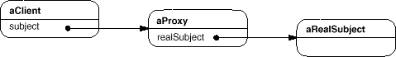
Proxy
●
Example object references

Slide 64
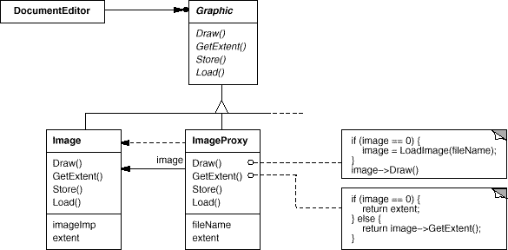
Proxy
●
Example: image proxy in document editor
●
Proxy stores image extent (width and height) to account for its placement in the document without actually loading the image

Slide 65
Proxy
●
Typical uses for proxy pattern
●
Remote proxy – local proxy represents a remote object
●
e.g. an ATM may have proxy objects for objects in a remote bank server
●
Virtual proxy – proxy creates expensive objects on demand
●
e.g. proxy for expensive elements (e.g. images) when loading a document
Protection proxy – controls access to an object based on access rights
Smart proxy – performs additional processing when accessing an object
●
●
●
e.g. count number of object references so object can be freed when there are no more references (smart pointer)
e.g. loading a persistent object into memory upon first reference
e.g. checking an object is locked before it is accessed so other objects can’t change it
●
●

Slide 66
Proxy
●
Pros:
You can control the real object without clients knowing about it
You can manage the lifecycle of the service object when clients don’t care about it
The proxy works even if the service object isn’t ready or is not available You can introduce new proxies without changing the service or clients
●
●
●
●
●
Open-closed principle
●
Cons:
●
The code may become more complicated since you need to introduce a lot of new classes
The response from the service might get delayed
●

Slide 67
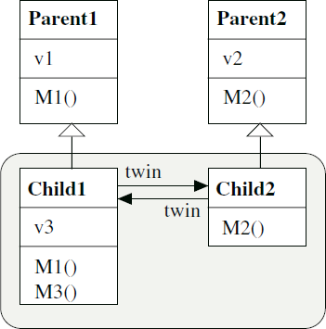
Other Structural Patterns
●
Not in the original GoF list:
●
Front Controller – a controller handles all requests directed to a website
Marker Interface – an interface is used to attach metadata to classes
Twin Pattern – mimics multiple inheritance by maintaining two closely coupled classes that each inherit from a different class
●
●

